Slide 1


The Ohio State AI/ML Course Project 2: Machine Learning Team 1 Wine Quality Prediction
19 March 2025

Slide 2

Executive Summary & Project Overview
In our project, we aimed to predict wine quality based on chemical properties using multiple machine learning models. by analyzing the UCI Wine Quality dataset, we trained and evaluated models such as RANDOM Forest, KNN, Decision Tree, Logistic Regression, SVM, and Naive Bayes to determined the best perfuming algorithm. The goal is to identify the key factors influencing wine quality and develop an accurate classification model.
Project Goals:
Data Preparation & Exploration – Clean, preprocess, and analyze the dataset to uncover trends in wine characteristics.
Statistical Analysis – Use ANOVA and correlation analysis to identify key relationships between chemical properties and wine quality.
Machine Learning Implementation – Train multiple models to predict wine quality and evaluate their effectiveness.
Model Selection & Optimization – Identify the best-performing model and validate it on unseen data.
Business & Scientific Insights – Provides meaningful interpretations of how chemical compositions affect wine quality for winemakers and industry professionals.
This project bridges data science and enology (wine science), demonstrating how machine learning can enhance quality control in the wine industry.

Slide 3
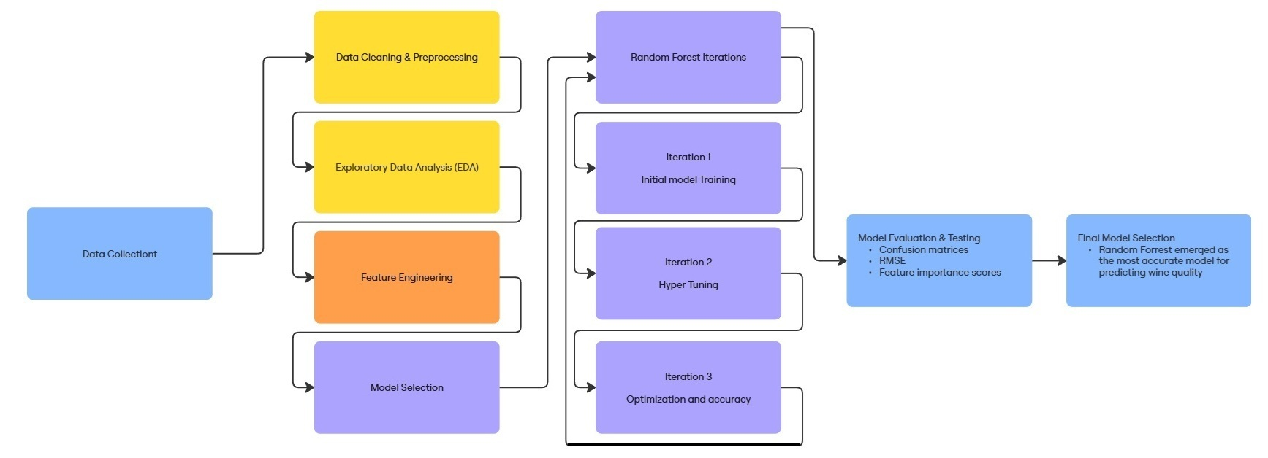
Pipeline Flowchart

Slide 4
Data Collection, Cleanup, and Exploration
The first phase of our project focused on data collection, cleaning, and exploratory analysis to ensure the dataset was structured and ready for machine learning applications. We used a wine quality dataset from the UCI Machine Learning Repository, which contains chemical properties of wines along with quality ratings assigned by wine tasters.
Data Collection & Cleanup:
The dataset was loaded from a publicly available repository.
We identified missing values and ensured all records were complete.
Column names were cleaned to remove unnecessary spaces and standardize naming conventions.
The dataset was split into red and white wine subsets to analyze each type separately.
We introduced a categorical quality label (quality_mark) to classify wines as low, medium, or high quality based on numerical quality scores.
Exploratory Data Analysis (EDA):
Box plots were used to visualize the distribution of chemical properties across different wine qualities.
Correlation heatmaps helped identify relationships between key variables (e.g., alcohol content, acidity, and residual sugar).

Slide 5
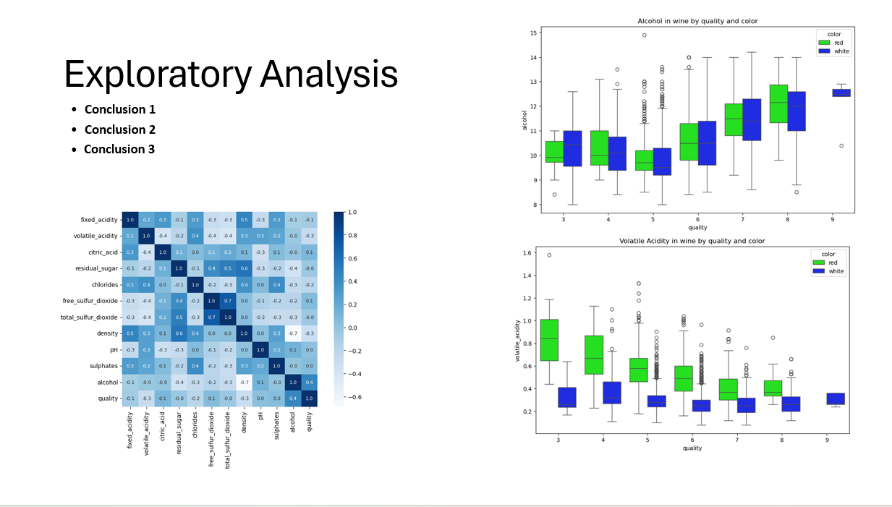
Project Approach

Slide 6
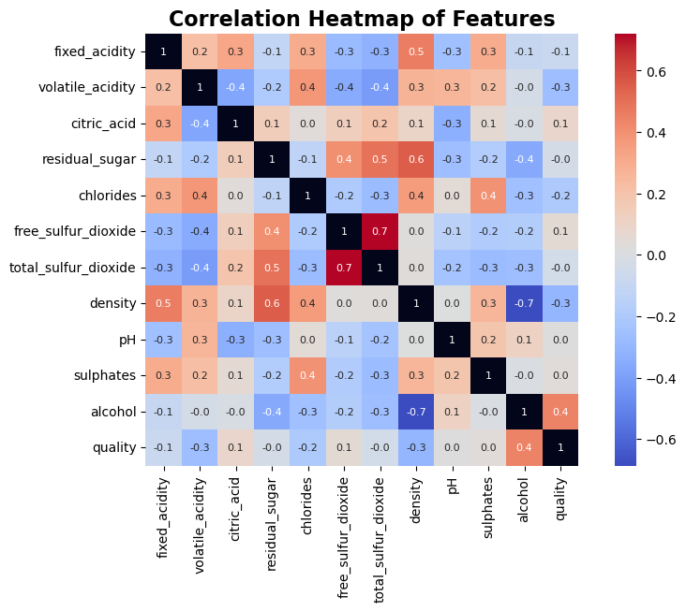
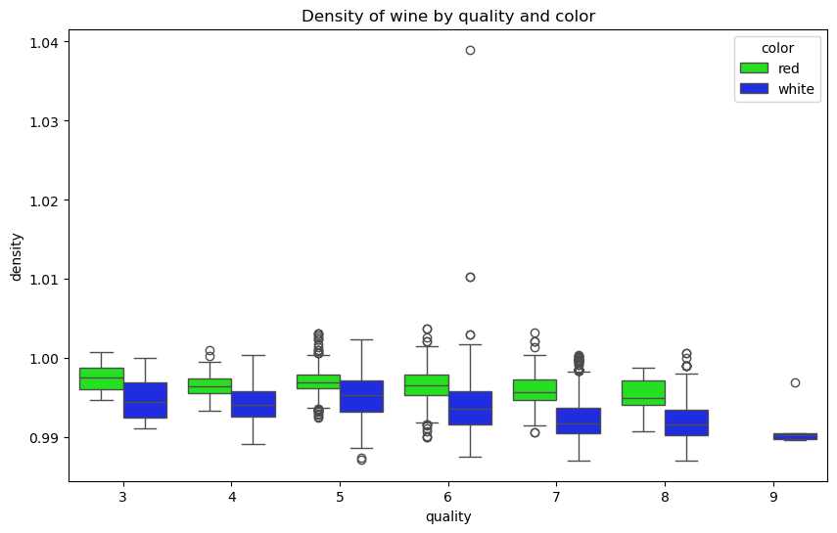
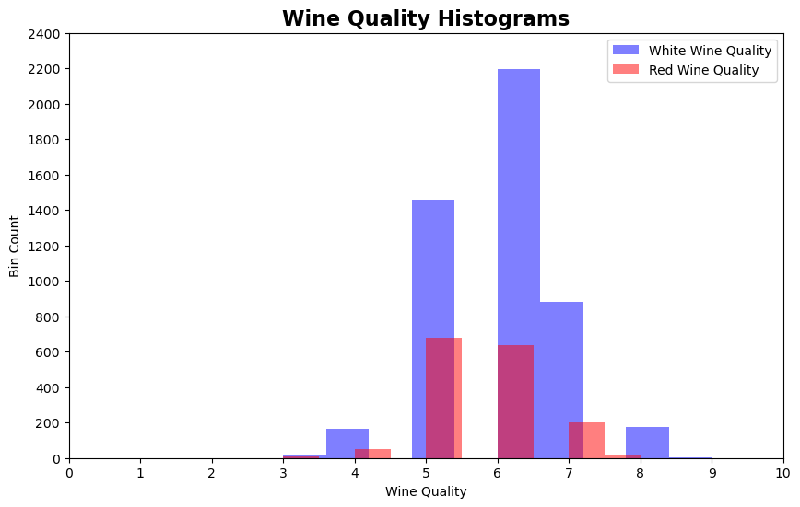
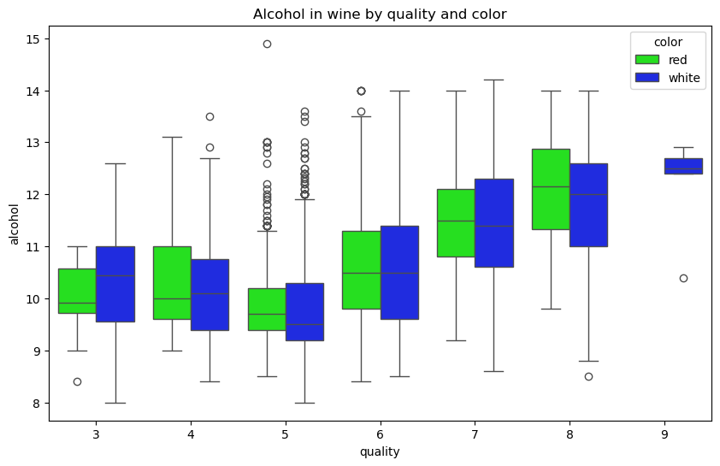
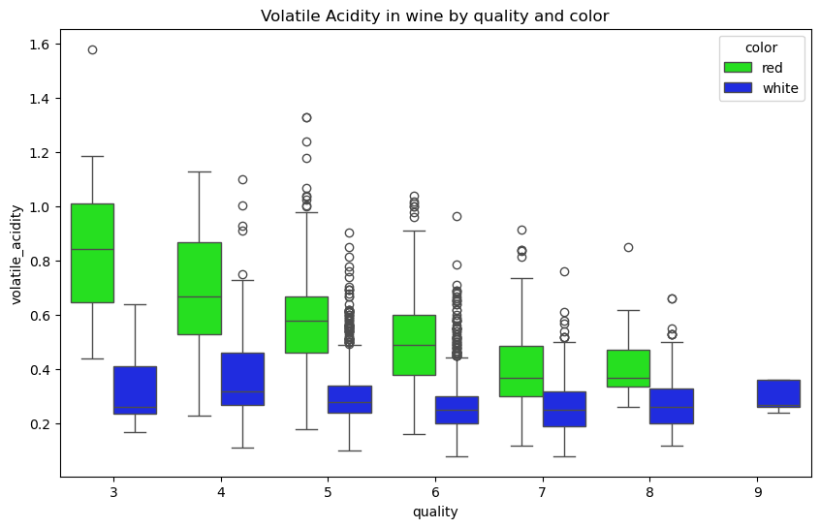
Exploratory Analysis
Analysis of the quality histograms revealed that most data was concentrated in the mid-range.
To address this imbalance, we consolidated the quality levels into three categories, ensuring a greater number of samples per level.
The correlation heatmap provided valuable insights into the key drivers of wine quality.
It also highlighted areas of collinearity, which influenced both the choice of model and feature engineering efforts.
Box plot analysis of various features demonstrated that feature trends were not consistent across wine color.
This finding prompted us to divide the dataset by color to enhance the accuracy of our analyses.

Slide 7
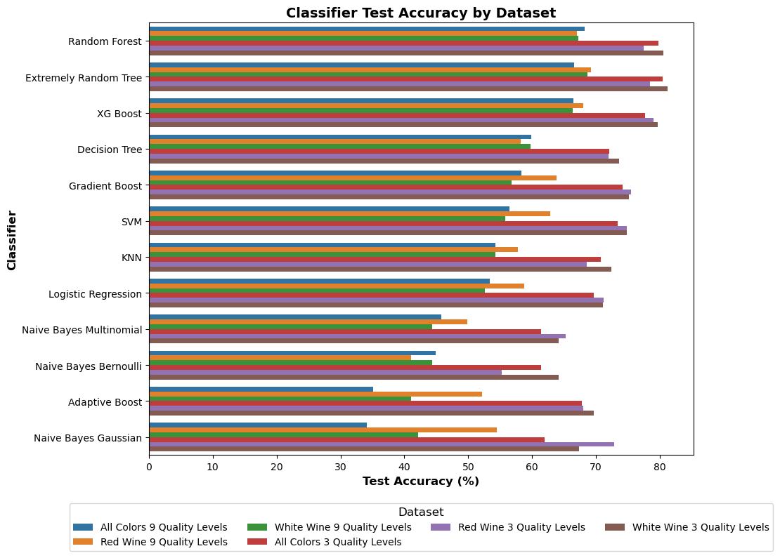
Model Selection & Best Model
After evaluating multiple models and datasets, we found:
The Random Forest model provided the best performance in predicting wine quality.
Slightly better performance on white wines can be achieved by diving the dataset on color.
Accuracy was much better with 3 quality levels as opposed to 3.
Random Forest on separate datasets and 3 quality levels was chosen for hyper tuning
Achieved the highest accuracy for both red and white wines.
Robustly handled feature interactions and collinearity.

Slide 8
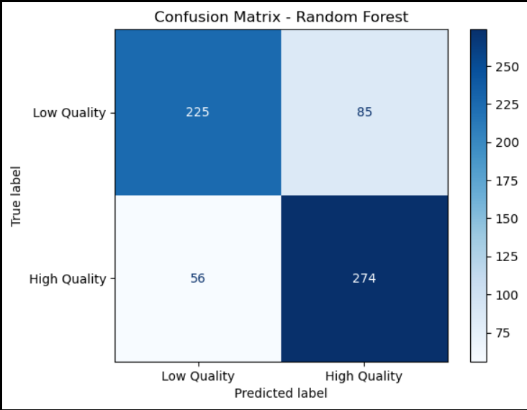
Model Selection & Best Model
Why Random Forest?
Best Performance: Achieved the highest accuracy for predicting wine quality (both red and white wines)
Robustness: Handles complex feature interactions better than simpler models
Comparative Advantage: Outperformed models like Logistic Regression and Support Vector Machines (SVM)
Final Selection: Chosen due to its balance of accuracy, interpretability, and reliability
Notes:
The confusion matrix provides a detailed breakdown of how well the Random Forest model classifies wine quality. Instead of just giving an overall accuracy score, it tells us the following:
How many correct and incorrect predictions were made for each class.
225 True Negatives (Low Quality correctly classified)
274 True Positives (High Quality correctly classified)
85 False Positives (Low Quality misclassified as High Quality)
56 False Negatives (High Quality misclassified as Low Quality)
It also gives insight into model performance beyond just accuracy.
Accuracy alone doesn't tell us which types of errors the model is making.
If False Positives are too high, the model may over-predict high-quality wines.
If False Negatives are too high, the model may be too strict in classifying wines as low quality.

Slide 9
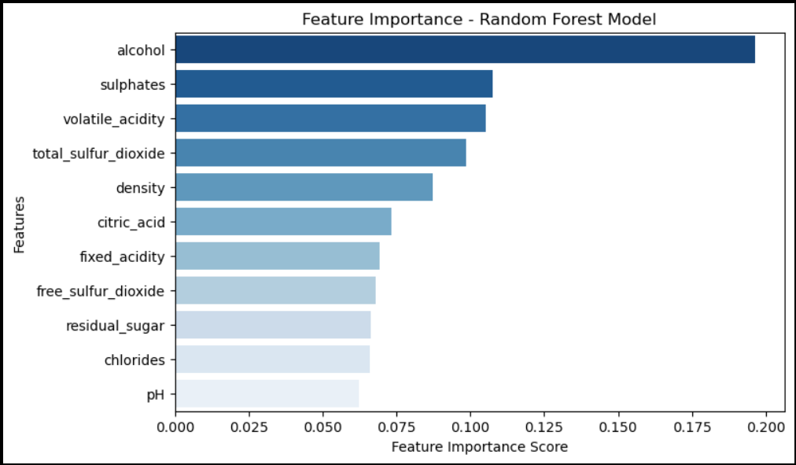
Random Forest Predictive Testing
Finally, we tested the trained Random Forest model on new, unseen data to assess its real-world predictive capabilities.
Key results:
Accuracy Results: Random Forest had the highest accuracy
Red Wine Accuracy: 84%
White Wine Accuracy: 83%
Model successfully predicted wine quality based on input features
Accuracy remained consistent with earlier evaluations.
Predictions were validated against expected wine quality levels.
Random Forest proves to be a strong and reliable model for predicting wine quality, offering high accuracy and interpretability.

Slide 10
Deep Learning Exploration: Neural networks could improve classification accuracy.
Expanding Data: Using additional datasets for better generalization.
Hyperparameter Optimization: Using Bayesian Optimization to fine-tune the model.
Deployment Plan: Implement the model as a Web API for real-world use cases.
Future Work
Team 1 identified the following points at the conclusion of our initial analysis to refine the dataset.
Explore: Deep Learning Models (Neural Networks) for better classification
Explore: Additional datasets for better generalization
Optimize hyperparameters using **Bayesian Optimization**
Deploy the best model as a **Web API** for real-world testing

Slide 11
Questions?

